Slide 1

Before We Begin...
All links can be found on: github.com/UWB-ACM/git-gud
Install Git (command line)
git-scm.com/downloads
Create a GitHub account if you don’t have one already.
github.com/
3. Open this URL for later:
bit.ly/ACMGitGud
Notes:
Should show this as people get into the room.

Slide 2
The ACM is a Global Organization, with nearly 100,000 members from more than 190 countries, ACM works to advance computing as a science and a profession.
_We Are Hiring New Officers!_
Go to bit.ly/HireMeACM to apply!
Notes:
Should show this as people get into the room.

Slide 3
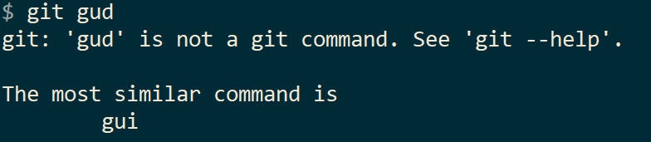
Git Gud
Workshop
By your friends at
UWB ACM
Presenters: Ryan Russell, Lizzy Presland
Notes:
Welcome everyone

Slide 4
Agenda
Introduction to Git
Commands Overview
Workshop #1: First Commit
Workshop #2: Sync Changes
Best Practices
Workshop #3: Collaborating with others

Slide 5
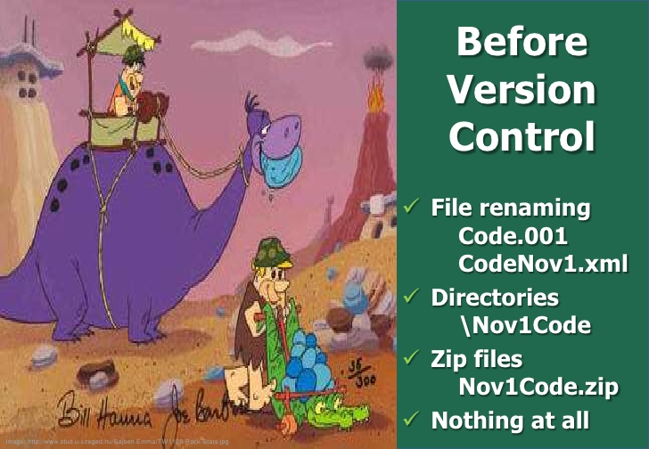
The Land Before Git
How have you worked on a project with multiple people in the past?
Did everyone code on their own machines and use a USB to exchange code?
Did you use a Google Doc that everyone edited?
Now imagine a project with 50 people. That’s a lot of USBs.

Slide 6
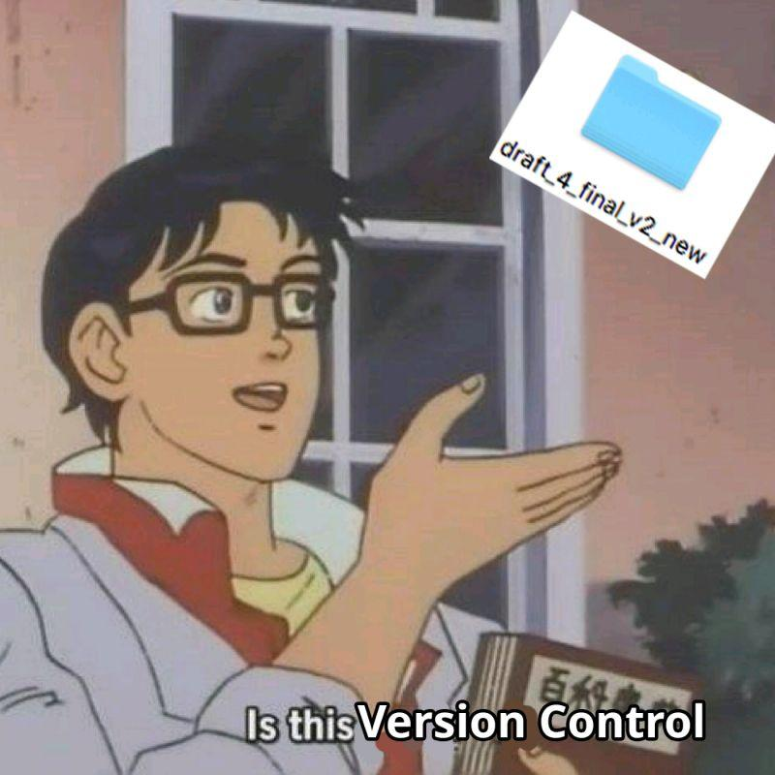
Notes:
Make sure to look happy

Slide 7
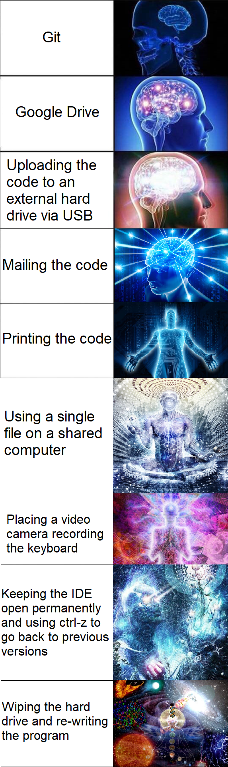

Slide 8
Introduction to Git
What version control is + why it matters

Slide 9
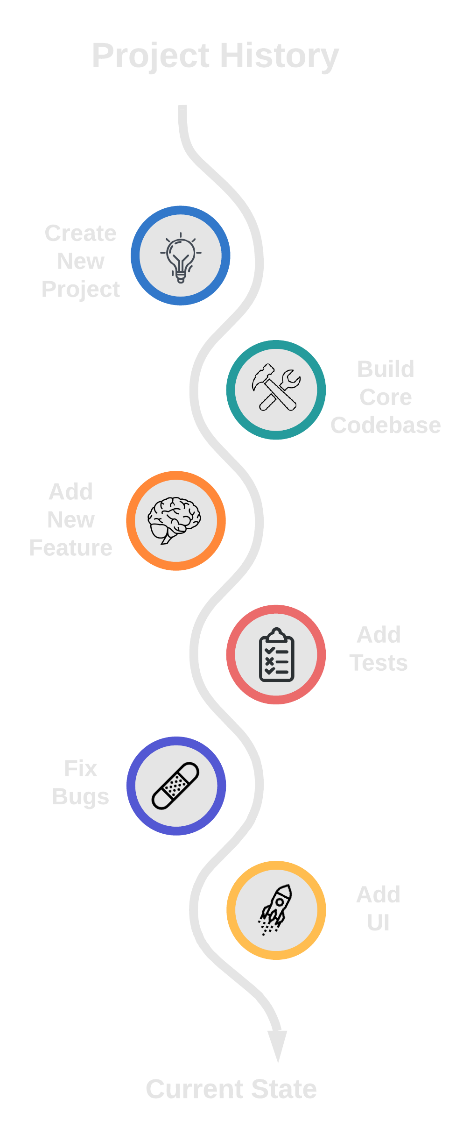
What’s Version Control?
Tracks changes
See which user(s) made changes to document(s)
Save the history of changes to a document
Shows the long-term evolution of document(s)
Implemented in cloud drive platforms
e.g. Google Drive
Notes:
Version control is a way for users to track, switch, and revert changes made to files within a directory.
This is probably something you’ve seen already (implemented in cloud platforms, document processors, IDEs, etc)
Ask audience “What’s the difference between this model and something like Microsoft Word on your laptop?” Answer: you typically only get the _current state_ of the document, not a _full history_ of revisions.

Slide 10


Linus Torvalds
Linus Torvalds, the creator of the Linux kernel, wanted a new form of version control.
The project’s goal was to synchronize code between fellow programmers and make the development process easy and lightweight.
So in April 2005, his team started development of Git.

Slide 11

What’s Git?
Version Control Software!
Powerful command-line toolbox
Used for:
tracking revisions to files
viewing revision history
selectively managing revisions by many different people
uploading new changes to remote file storage
Notes:
Git is essentially version control software with a command-line interface, and is used widely throughout this industry.
Not to be confused with Github (more on that later).

Slide 12



What isn’t Git?
Git != GitHub
GitHub is a remote file storage platform that uses Git
Git != Google Drive
(Git doesn’t sync in real-time)
Think about it like:
Git is the interface and GitHub is the storage
≠
≠
Notes:
While Git and GitHub have similar names, they are completely different pieces of technology. GitHub uses Git to be able to host online Git repositories, whereas Git is just a CLI application.
Google Drive doesn’t have as tight of version control as Git does, and are unrelated to each other.

Slide 13
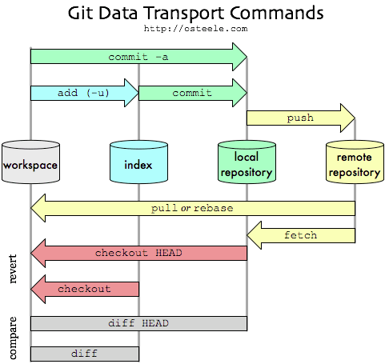
Why Git?
Keep files in sync!
Among workstations
Among teammates
Backup source code
Hard drive crashes
Distributed collaboration
Work remote!
Manage complex workflows
Bug fixes, new features, release cycles, and more!
It’s great for code!
Notes:
Git provides powerful version control software, while still being lightweight enough to be able to integrate into most project setups and workflows
Git can be used for both technical and non-technical projects. If it needs version control, it can use Git

Slide 14
Who Uses Git?
Industry leaders in software!
Amazon, Microsoft, Facebook, Netflix, Twitter, Linux, Android, Eclipse, Starbucks, Google, Hashicorp, eBay…
Open source developers!
Tens of millions of users on GitHub, GitLab, BitBucket, SourceHut, and others
Hosted on GitHub: NodeJS, Kubernetes, React, Bootstrap, OpenCV, and many other major software projects!
Your classmates!
Some professors (like Prof. Pisan) structure programming assignments in GitHub Classroom
Many other students use it on their own or for group projects
Notes:
Git is essentially version control software with a command-line interface, and is used widely throughout this industry.
Not to be confused with Github (more on that later).

Slide 15
Usage
How to use git

Slide 16
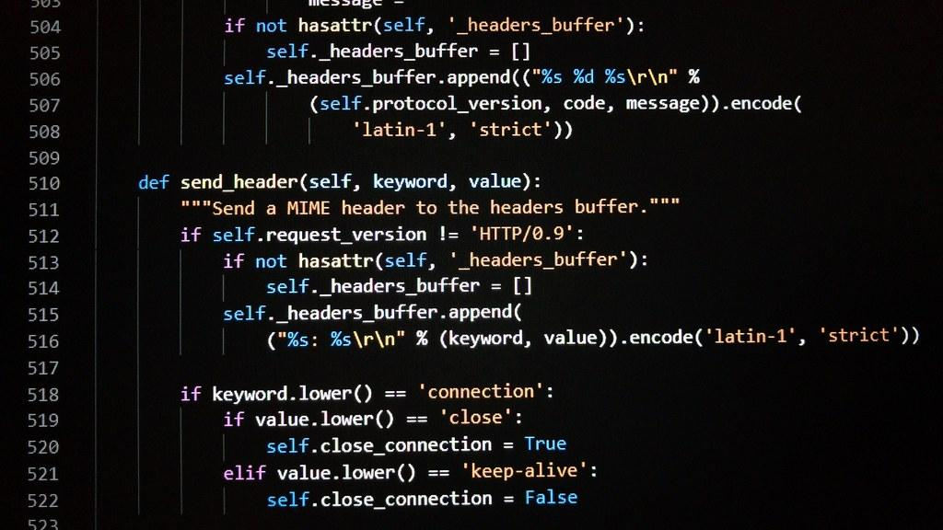

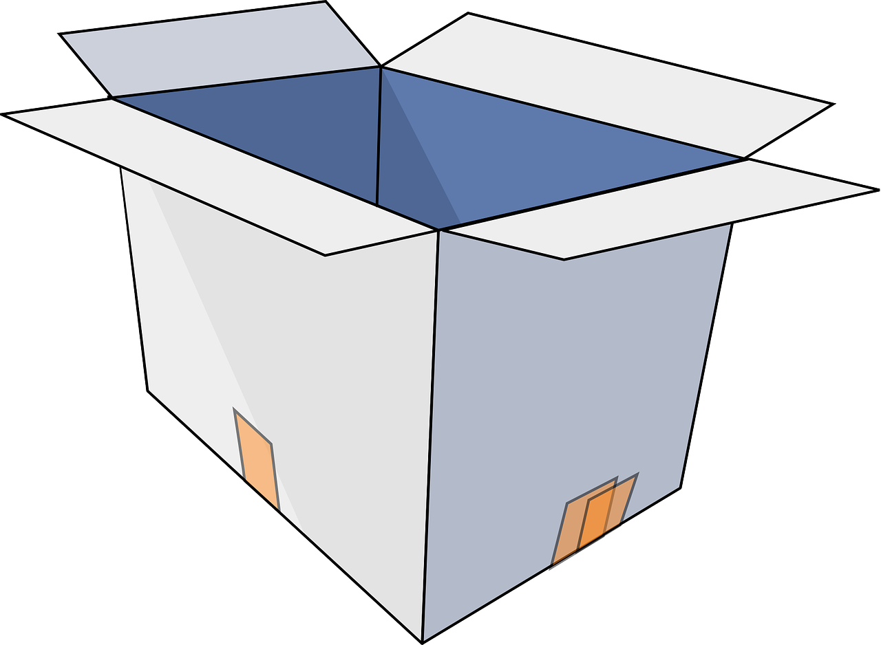
How Local Usage Works - Overview
Step 1 - Code
Step 2 - Stage
Step 3 - Commit
Code on your local computer.
Choose which file changes you want to save.
Save your changes to your code in a commit.
We’ll go into more detail later in this workshop

Slide 17


How Remote Syncing Works - Overview
Step 1 - Pull
Step 2 - Commit
Step 3 - Push
Download (aka pull) new changes and update your local copy of the repository.
Upload (aka push) your commit(s) to the server.
Now others can view the code with your changes included.
Make changes and save your changes in a commit.
We’ll go into more detail later in this session

Slide 18
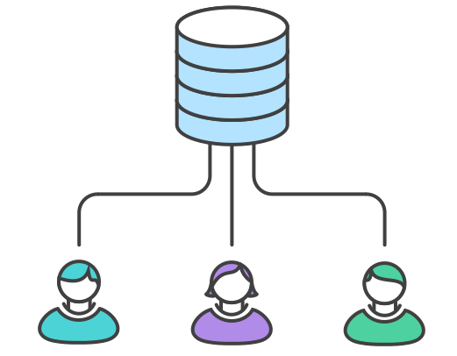


How Collaboration Works - Overview
Multiple people can collaborate on the same code easily.
Bugs, feature requests, and large projects can be tracked alongside the code.
Collaborators can easily review each other’s code to find bugs faster and build better software.
We’ll go into more detail in the second session, Git Better (2/28/2020)

Slide 19
Workshop #1
Create your first commit

Slide 20
Vocabulary: Repo
Code
Commit
Upload
Repo / Repository
A directory tree which is named .git.
The repository contains a representation of the contents of a directory tree, or project, on your computer.
Git tracks changes to files in your project, and stores the revision history of the project in the repository folder.

Slide 21
Vocabulary: Commit
Code
Commit
Upload
Commit
A set of changes applied to files which is permanently saved to the repository history.
A commit is always linked to one or more previous commits (called parents), creating a chain of revisions.
Commits also have authors and messages associated with them, detailing who created the changes and why.
Commits are uniquely identified using a SHA256 hash.

Slide 22
Vocabulary: More Goodies
Code
Commit
Upload
Status
The current state of your repository. It has lots of great information. If (or when) you feel lost, run git status to see what’s up with your project.
Staging
Staging changes in git ensures those changes will be included in your next commit.
Typically, this is done through the git add command.
The staged changes will be in your staging area until you commit them or remove them from the staging area.

Slide 23

Git Config (First-Time Setup)
Git needs to know your username and e-mail to associate your work with you.
This is the information included in the “author” metadata for commits.
Use the following commands:
git config --global user.name “Bobby Tables”
git config --global user.email bobby@tables.com
Notes:
TODO double check that these are correct

Slide 24
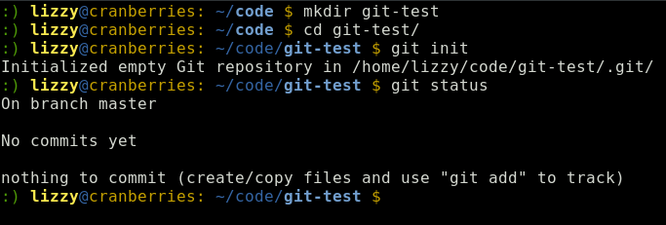
Commands: Creating the Repo
git init : Makes the current directory into a Git repository.

Slide 25
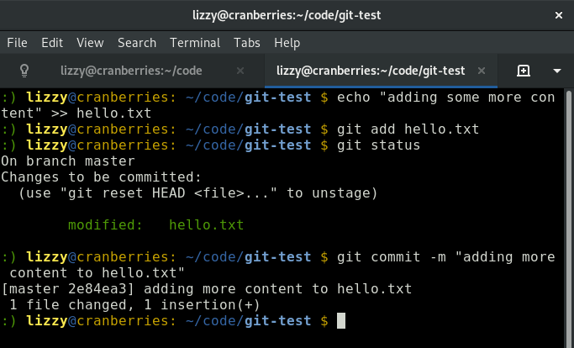
Commands: Make changes to repo
git add [files] Adds the specified files to the staging area.
git commit Associates a message with the changes in the staging area, and add these changes to the repo’s history.
Notes:
What is the “staging area”?

Slide 26
Workshop 1: Purpose and Outcome
Purpose:
Create a local repository, and commit a file to it.
Outcome:
A local repository with the created file in it.

Slide 27
Workshop #1: Our First Commit
Step | Task | Command
1 | Create a local repo | mkdir git-gud && cd git-gud git init
2 | Create new file(s) | echo “Hi!” >> hello.txt
3 | Check repository status | git status
4 | Add files to our index | git add hello.txt
5 | Commit changes to local repo | git commit

Slide 28
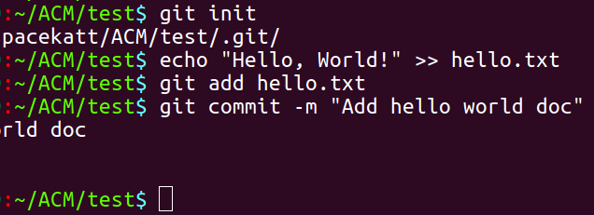
Workshop #1: Example
Initialize repo
Add file to index (staging area)
Create text file
Commit file to repo
Notes:
TODO make some nicer screenshots

Slide 29
Workshop #2
Sync Local Repository to Remote Repository

Slide 30
Vocabulary
Code
Commit
Upload
Remote
The repository’s remote points to a remote storage endpoint which contains a copy of the current repository.
The remote has a name; a common convention is to call the remote origin.

Slide 31
Vocabulary
Code
Commit
Upload
Push
Sync local changes to the repository by uploading local commits to remote storage (GitHub, GitLab, BitBucket, SourceHut, private servers, etc.).
Pull
Retrieve changes from repository by downloading commits from remote storage.
Note: you can only run push & pull when you have a remote identified in your repository.

Slide 32
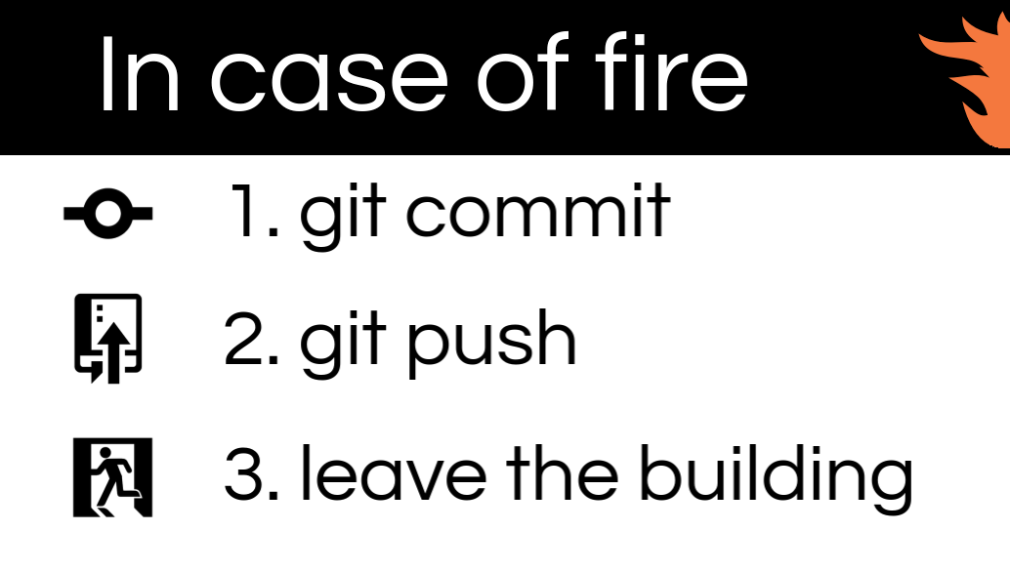
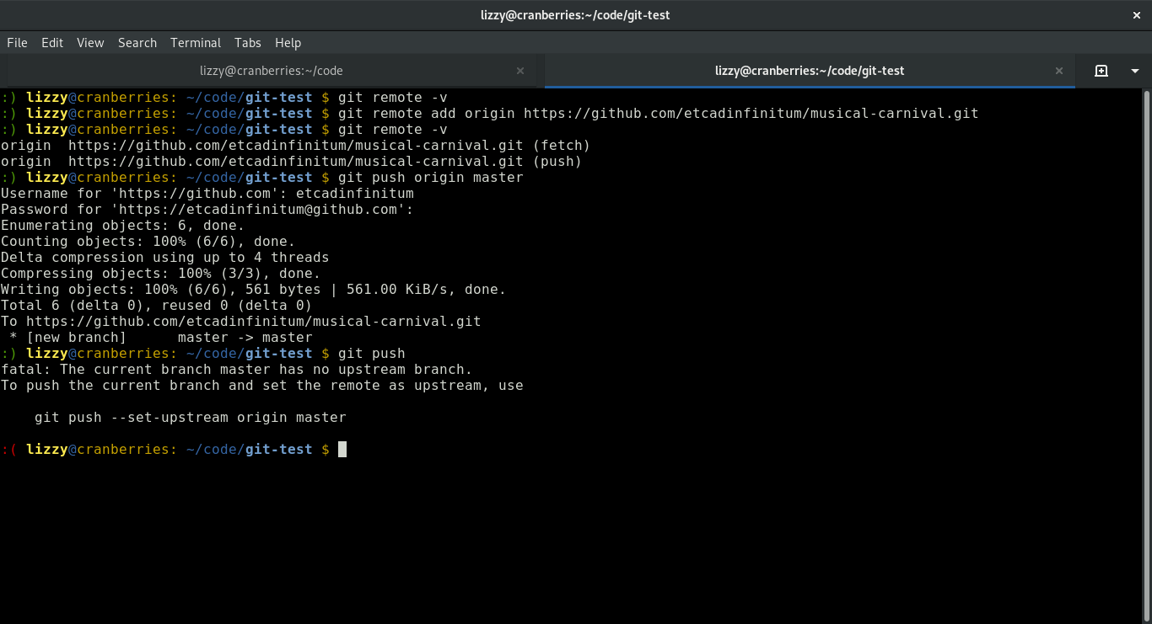
Commands: Syncing with remote repo
git remote -v : get information about remote repositories associated with the local repository
git remote add <nickname> <URL> : associates a local repository with a remotely hosted repository (GitHub, GitLab, etc)
git push <nickname> <branch> : Uploads changes.
git pull <nickname> <branch> : Downloads changes.

Slide 33
Workshop #2: Syncing to remote (GitHub)
Using the repository from Workshop #1...
Step | Task | Command
1 | Create remote repo (on GitHub) | <Create repo on GitHub>
2 | Add reference to remote (URL) locally | git remote add origin <remote url>
3 | Sync local changes to remote | git push -u origin master

Slide 34
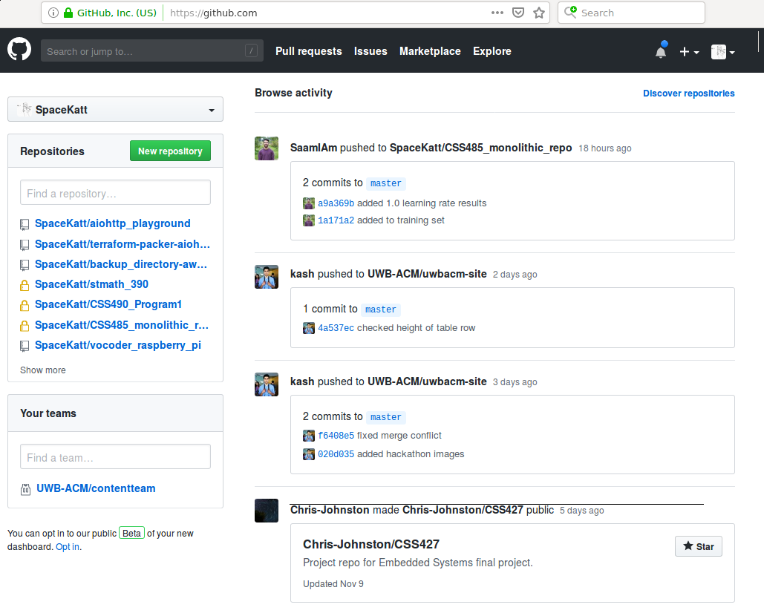
Create New
Repository
Click da’ button!

Slide 35
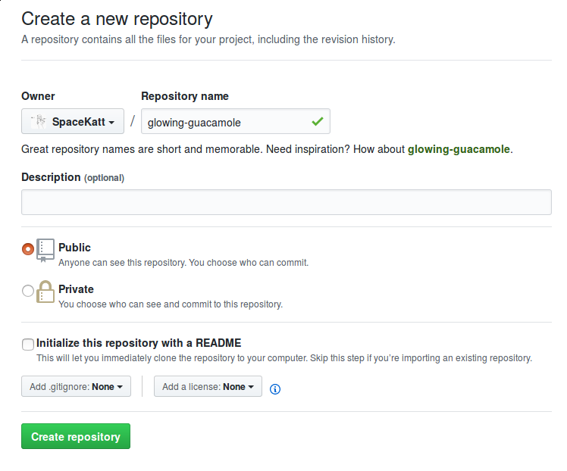
Name New
Repository
Give your new repository
some name…
If you’re hosting a cool project,
then use a descriptive name!
Don’t include a README, .gitignore, or license yet.

Slide 36
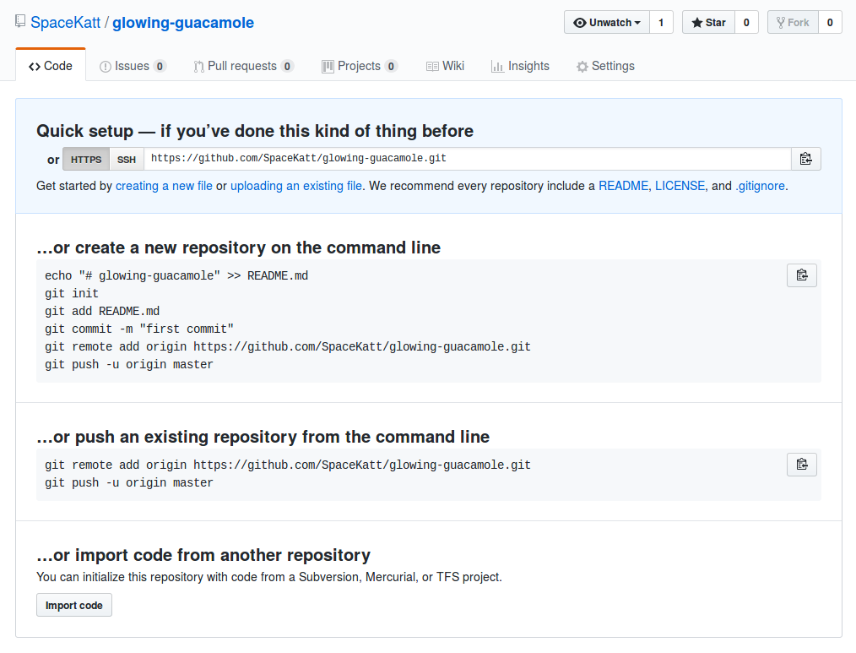
Copy URL
of repo
Click da’ button to copy
to your clipboard
Keep this page open
We will refresh it after
the next step!

Slide 37
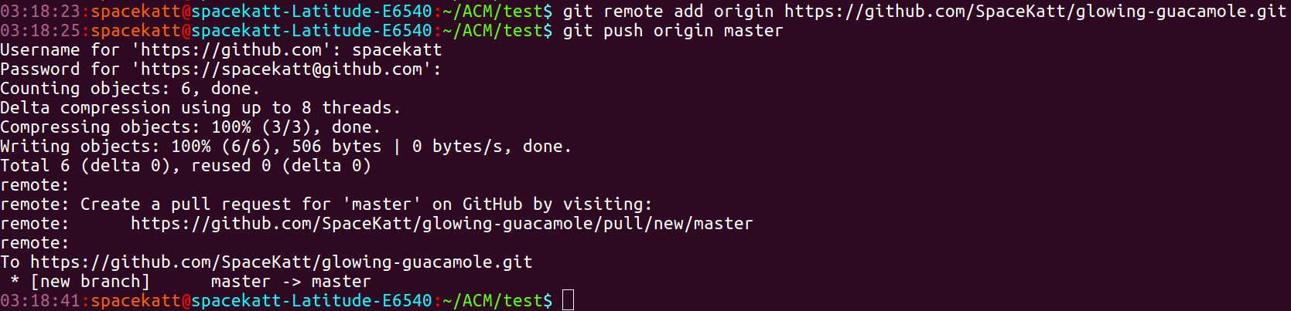
Add remote and push!
Add reference to the remote repository
Sync remote with local repo with push

Slide 38
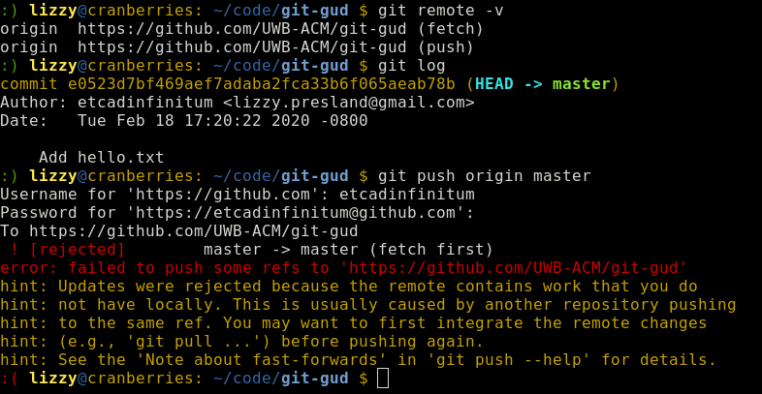
Uh Oh!
Help! I got a scary error message!
You may have accidentally created a commit in the remote repository. (README, license, .gitignore…)
The remote repo has commits that your local repo doesn’t have -- they are out of sync!
Don’t worry -- this is easy to fix!

Slide 39
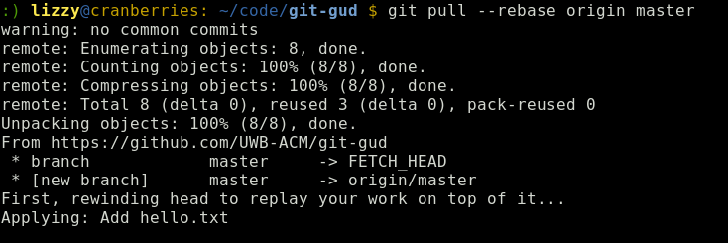
Uh Oh! [RESOLVED]
We can fix this very easily!
We need to update our local repository with the changes we don’t have. To do this, run: git pull --rebase origin master
Then, try pushing your changes again.
Note: More on this in Workshop 3

Slide 40
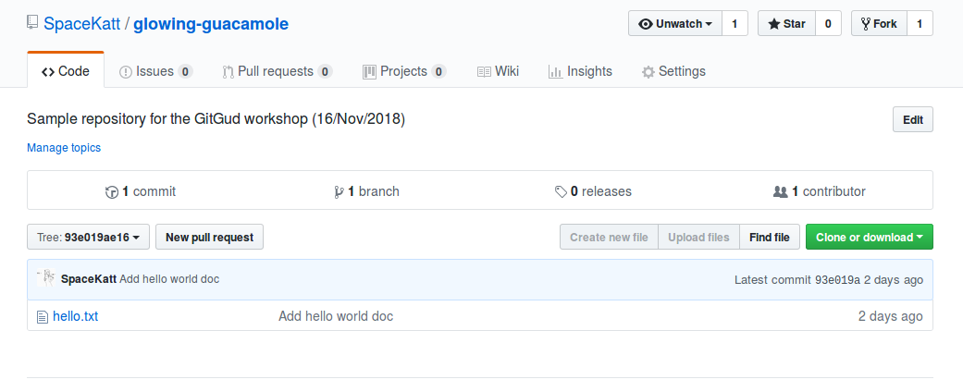

Refresh Repo Page on GitHub
We now see the file we pushed to our remote, origin
Exciting!
Much open source!
wowe
Heckin’ origin

Slide 41
Best Practices
Git Gud, Git Gr8, m8

Slide 42
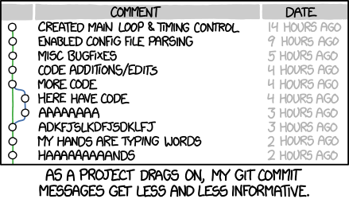
Writing Good Commit Messages
Qualities of a good commit message:
Use the imperative mood
“Add config file”
“Fix nginx SSL bug”
Subject is clear and descriptive, while under 50 characters in length.
Body adds detail and explanations
Avoid using git commit -m (do as I say, not as I do)
Further reading:
https://chris.beams.io/posts/git-commit/
https://help.github.com/articles/closing-issues-using-keywords/

Slide 43
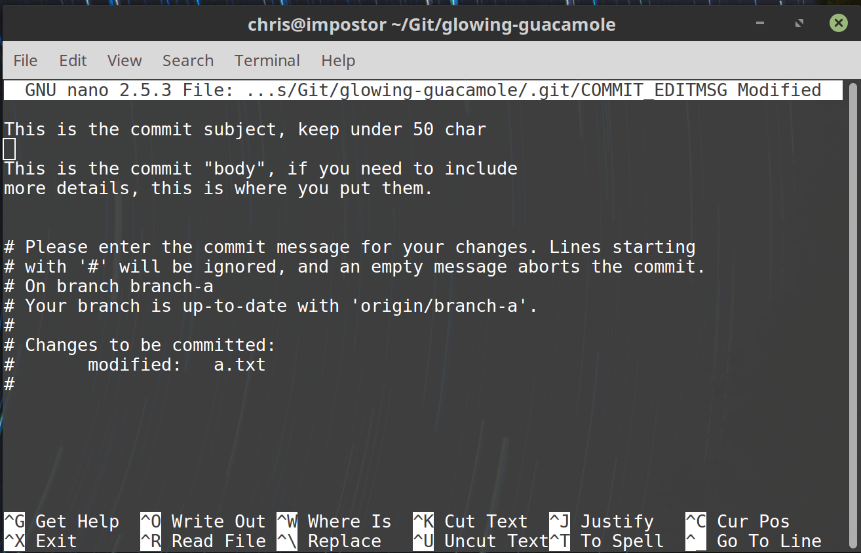
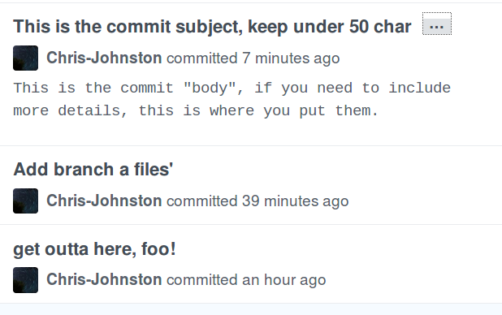
Commit Message Example
What you will see:
How others will see your message in GitHub:

Slide 44
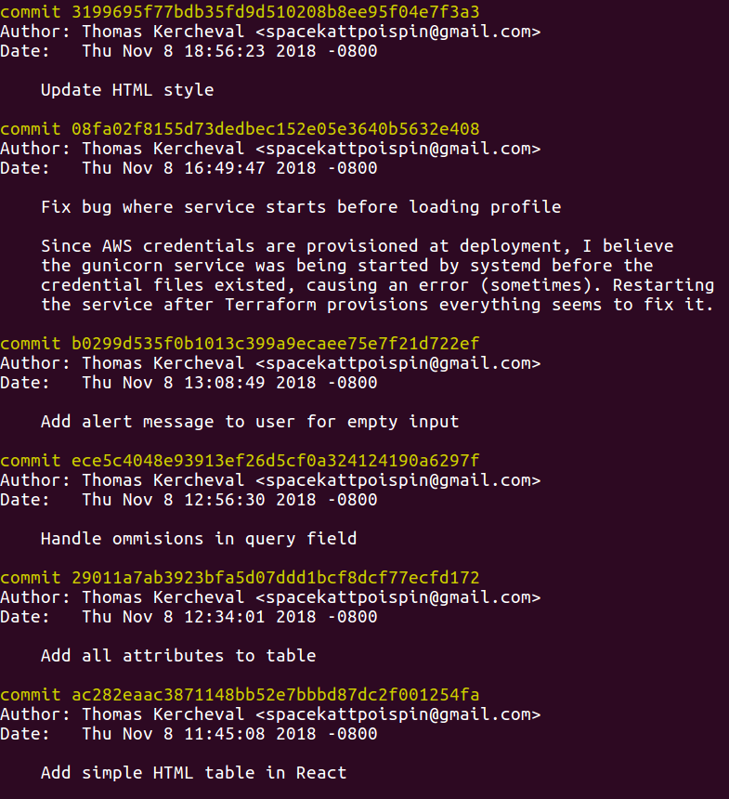
Viewing the log
View previous commit messages with...
git log
Benefits of a well-kept log...
Workflow transparency
Process traceability
Bug tracking
Smaller commits
Easier merging

Slide 45
Workshop #3
Handling Merge Conflicts

Slide 46
What is a merge conflict?
Imagine 2 people are working on the same file.
Each person has their own copy of the file, and they make changes.
What happens when the two people change the same line of code?
Who’s code do we decide to keep?
Merge conflicts happen when multiple people edit the same line in the same file.

Slide 47
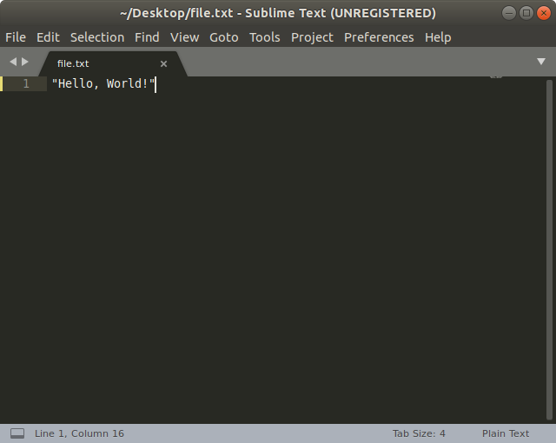
Merge Conflicts: Example
Let’s say we have a file called file.txt
Johnny changes line 1 to say “Hello, World!”
He then pushes the changes to the repository.

Slide 48
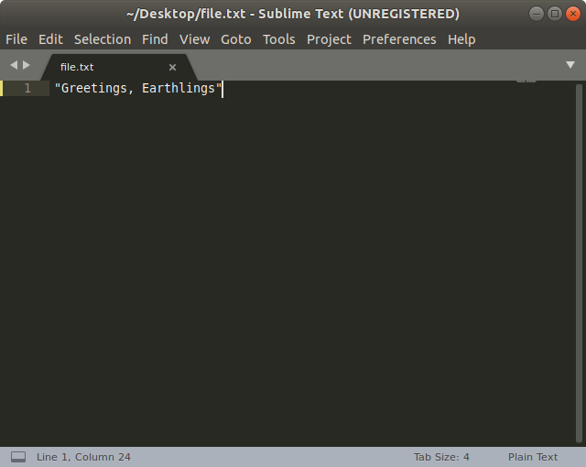
Merge Conflicts: Example
Without first pulling the file, Sally changes line 1 to say “Greetings, Earthlings”

Slide 49
Merge Conflicts: Example
file.txt in the Remote Repo
file.txt in Sally’s Repo
How can we decide who’s code to keep?
It’s simple: You get to decide

Slide 50
@Everyone Find a partner!
This next activity will require you to work in pairs. Yes, that means you will have to socialize. I’m sorry.

Slide 51
Workshop 3: Merge Conflict Exercise
Partner 1: Share the link to the GitHub repo we created in Workshop #2 to Partner 2.
Partner 2: Clone the GitHub repo.
Partner 1: Change line 1 of your file to “Hello!” and push it to GitHub.
Partner 2: DO NOT PULL - Change line 1 in the same file to “Bye!”
Partner 2: Push your changes. Read the error message. Welcome to your first merge conflict!

Slide 52
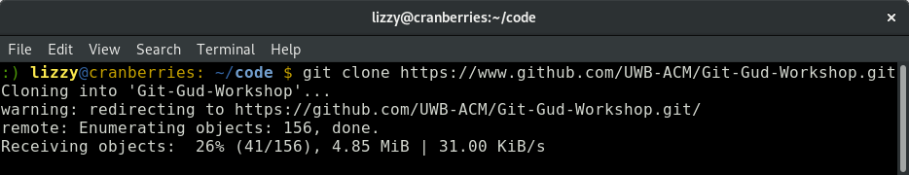
Commands: Creating/Connecting to Repo
git clone [url] : Downloads a repo from the given URL into a new folder.

Slide 53
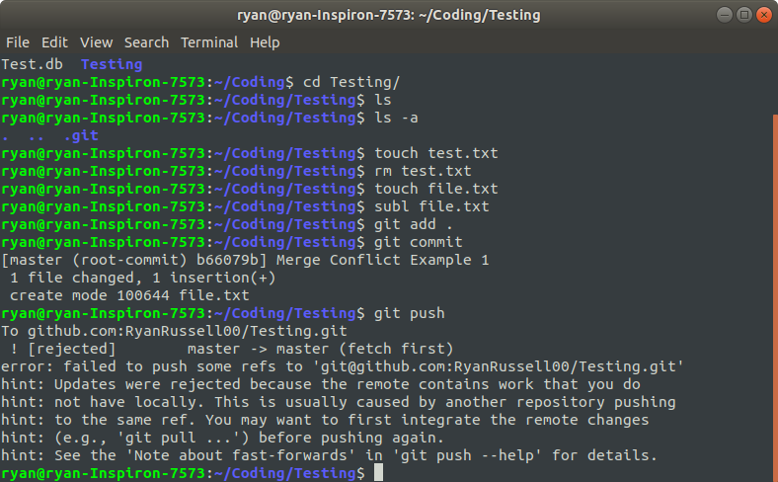
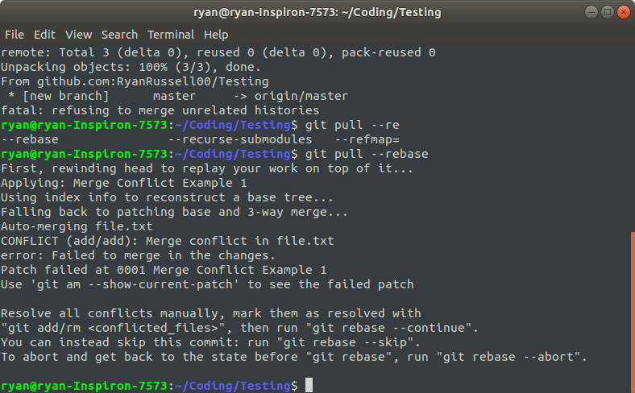
Partner 2 should have seen a message like this when they did git push
Partner 2: Run git pull and read the output
There should be a message like this:
Conflicted File
Line Number of Conflict

Slide 54
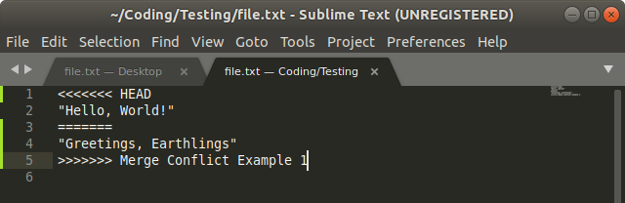
Reading the Merge Conflict
This is what your file looks like when you have a merge conflict:
Start of incoming changes
End of incoming changes
AND Start of current changes
End of current changes
Commit message of the commit causing the conflict

Slide 55
Solving the Merge Conflict
Let’s say we want our current changes to override the remote changes.
Quick & Easy Solution: Delete the code that you don’t want! Make sure to delete the <<HEAD, ==, >>>, and Commit Message
Attend Day 2 to learn better ways of solving merge conflicts!
Feb 28 - Same Room - Same Time

Slide 56
Lessons Learned
Why git is important
How to make a commit
How to push local repository to remote (GitHub)
How to manage files with git
How to contribute to open source projects
Git is fun!

Slide 57
The ACM is a Global Organization, with nearly 100,000 members from more than 190 countries, ACM works to advance computing as a science and a profession.
_We Are Hiring New Officers!_
Go to bit.ly/HireMeACM to apply!
Notes:
Should show this as people get into the room.

Slide 58
Questions?
Comments?
Concerns?
Join us next week for advanced
topics on git usage!
Slides available at bit.ly/ACMGitGud

